Slide 1
Basic Coding Course
Week 3 – Javascript – Conditional & Loop

Slide 2
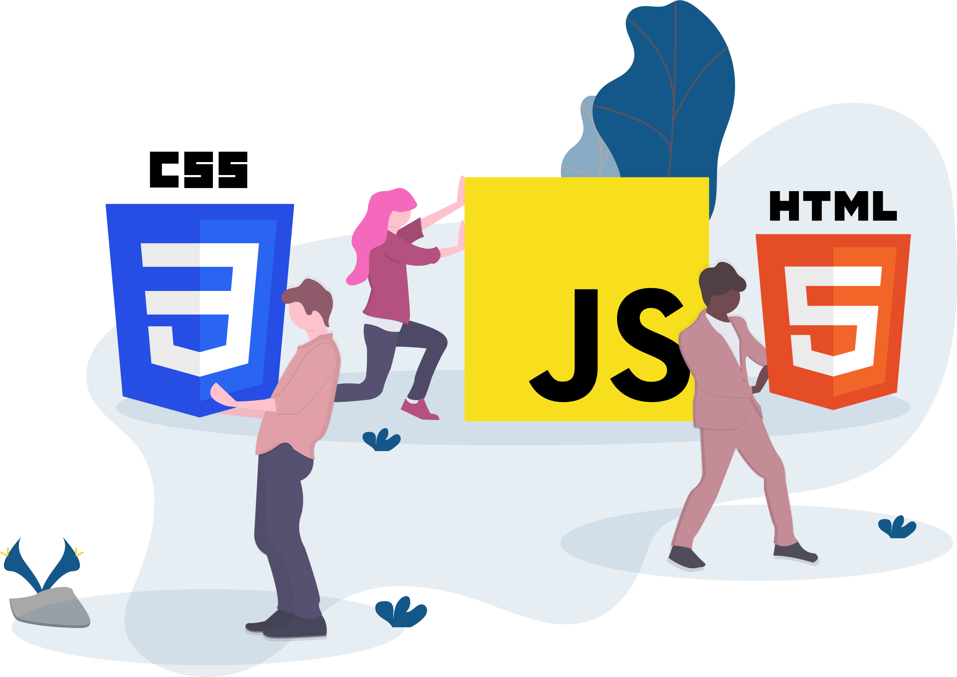
Conditional Statement
Section 1

Slide 3
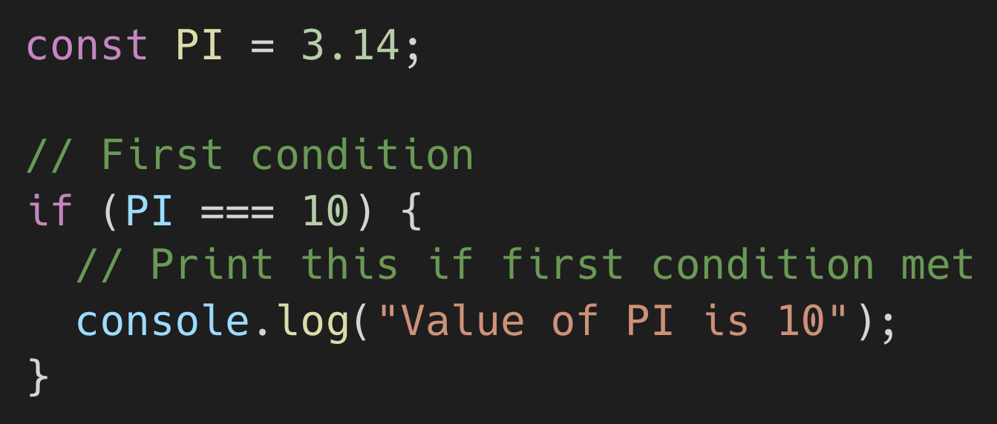
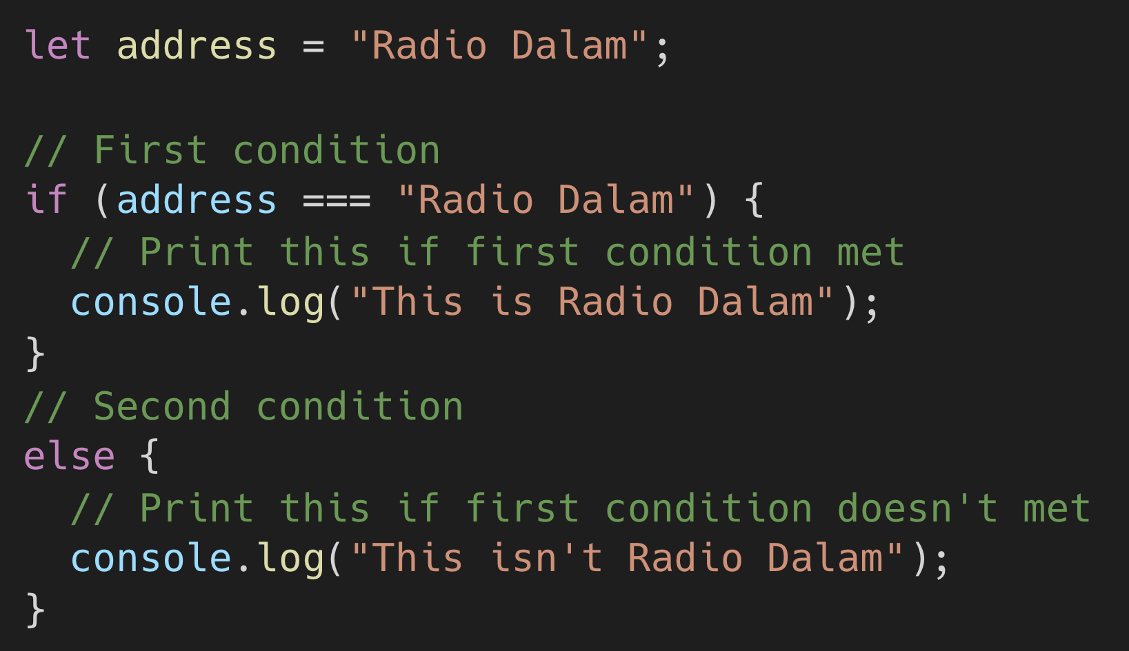
If, else, and else if Statement (1)
If statement is one of the keys used for branching. Branching means we can execute certain program code when conditions are met. Almost all of programming language supported if, else, and else if statement, even Microsoft Excel too.
If statement
If + else statement

Slide 4
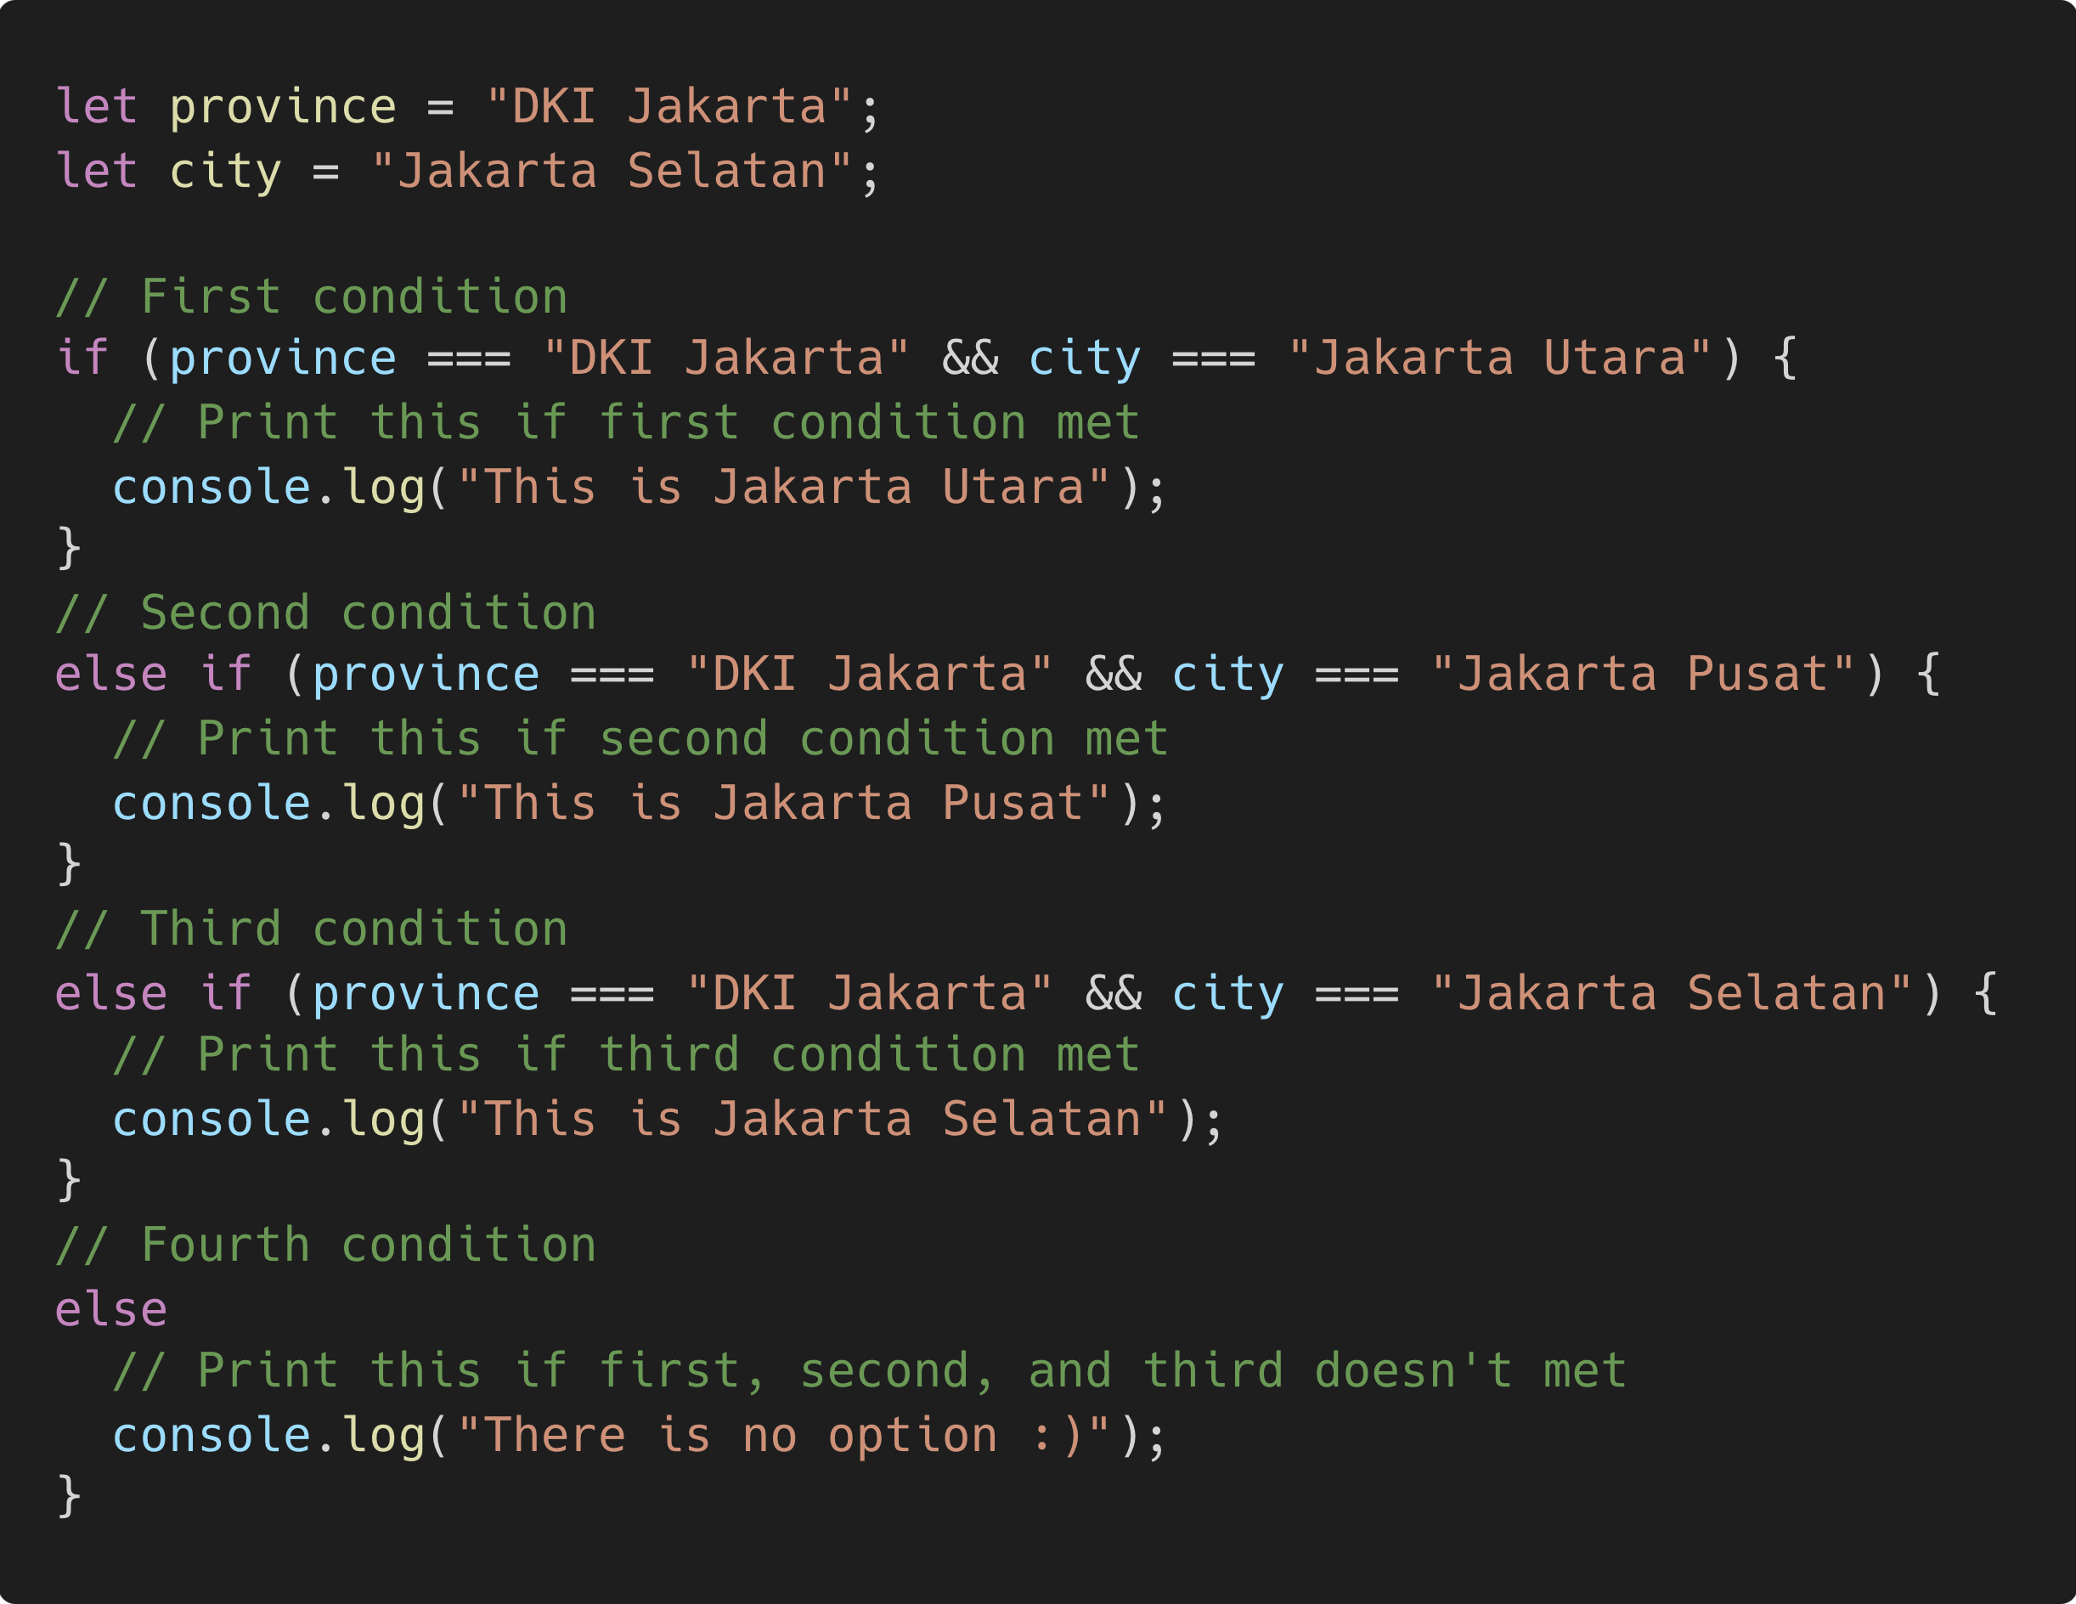
If, else, and else if Statement (2)
If statement is one of the keys used for branching. Branching means we can execute certain program code when conditions are met. Almost all of programming language supported if, else, and else if statement, even Microsoft Excel too.
If + else if + else statement

Slide 5
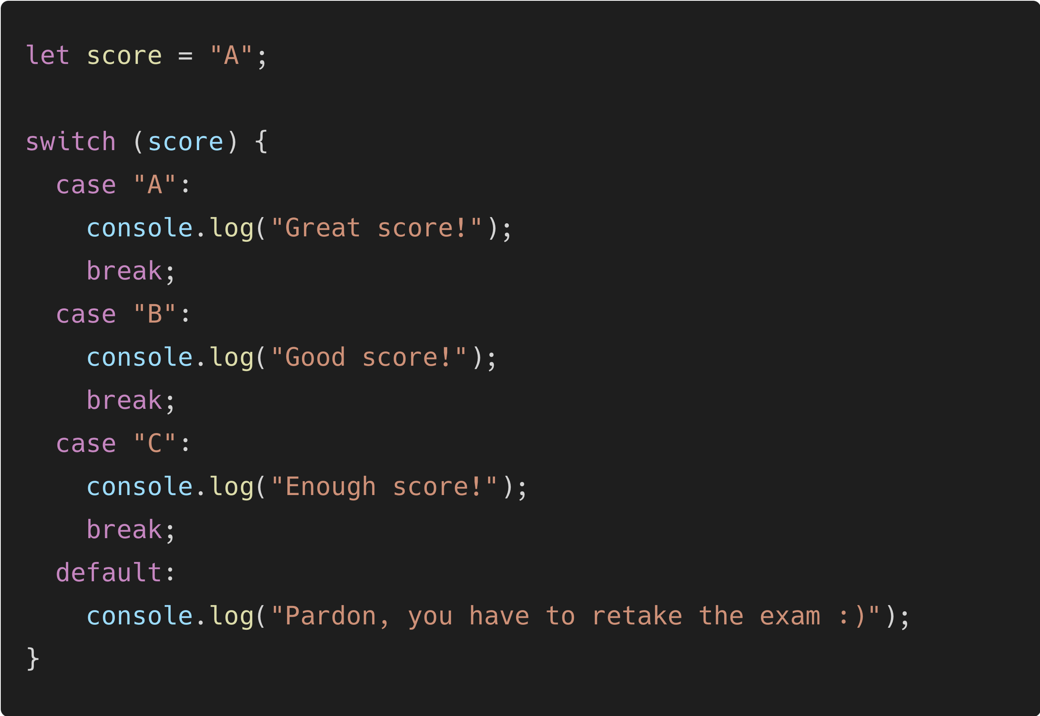
Switch Statement
Switch statement is one of the keys used for branching, same as an if statement, but operation and used most simplify. Switch statement commonly used for conditions with 1 value which want to validate.
Notes:
break = for stopping block of code certain if the case is met.
default = block of code in default could run if any case isn't met.

Slide 6
Arrays & Objects
Section 2

Slide 7
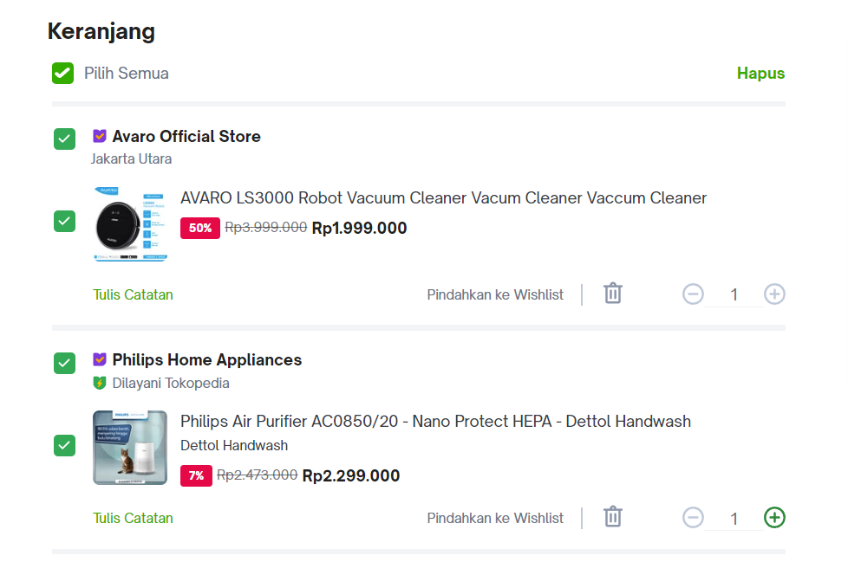
Array & Objects
Arrays: An array is like a shopping cart. Just as a shopping cart is a collection of items you need to buy at the store, an array is a collection of values in JavaScript. Each item corresponds to an element in the array. You can add new items to your shopping list, remove items, and access items by their position on the list.
Objects: An object is like the items in the shopping cart. It has properties such as product type, price, brand, quantitiy, etc. and also their corresponding values. Each property in the object is like a piece of information on the item, and you can access or update these properties as needed.
Product Object
Shopping cart array

Slide 8
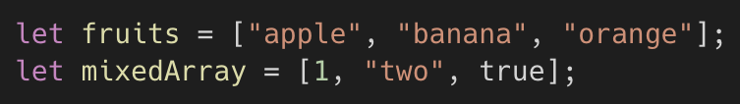
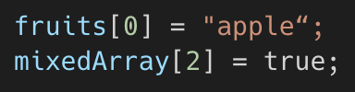
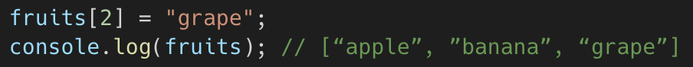
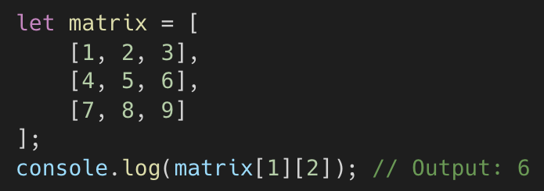
Array
An Array is an ordered list of values enclosed in square brackets ([])., each identified by an index. Arrays are used to store collections of similar or related items with mixed data types,
Array elements are accessed using zero-based index (the first element is in index = 0).
Array elements can also be modified by assigning values to a specific index.
Arrays can contain other arrays, creating a multi-dimensional structure.
Note: A “string” can also be considered an array with value of each characters, but you can only read the value for each index and NOT reassign it.

Slide 9
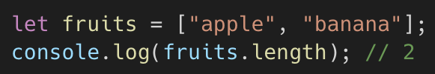
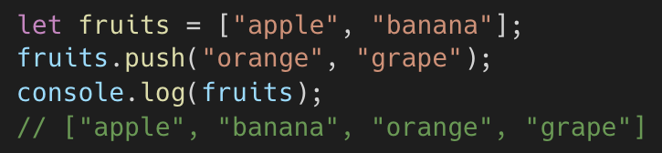
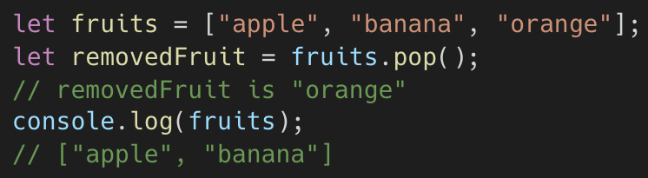
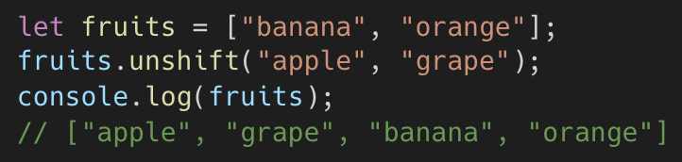
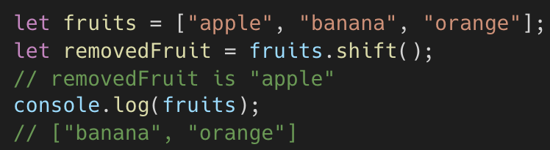
Array Methods (1)
Methods | Function | Example
array.length | Finds the total number of data in an array
array.push(value1, value2, …); | Adds one or more elements to the end of the array. Returns the new length of the array.
array.pop() | Removes the last element from the array. Returns the removed element.
array.unshift(value1, value2, …) | Adds one or more elements to the beginning of the array. Returns the new length of the array.
array.shift() | Removes the first element from the array. Returns the removed element.
Note: Some of this methods directly mutates the original array.

Slide 10

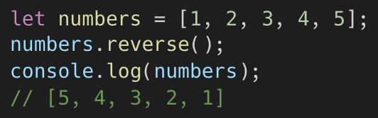
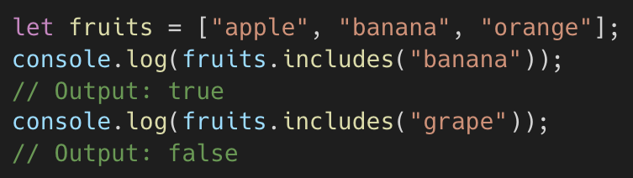
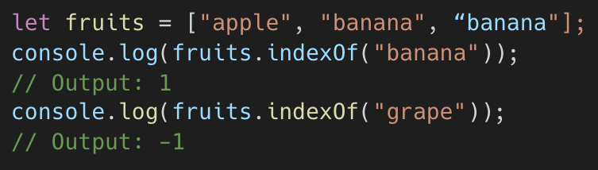
Array Methods (2)
Methods | Function | Example
array.sort() | Sort the elements of an array in place and return the sorted array. By default, it sorts elements as strings
array.reverse() | Reverses the order of elements in the array.
array.includes(element, fromIndex); | Check if an array includes a specific element. It returns a boolean value (true or false) indicating whether the element is found in the array. fromIndex are optional. If not provided, the search starts from index 0
array.indexOf(element, fromIndex); | Find the index of a specific element in an array. It returns the first index at which the element is found, or -1 if the element is not found. fromIndex are optional. If not provided, the search starts from index 0
Note: some of this methods directly mutates the original array.

Slide 11
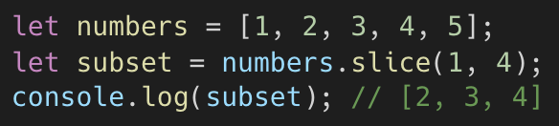
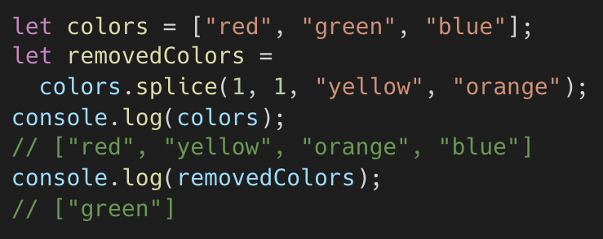
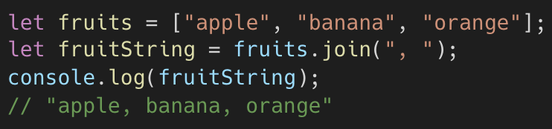
Array Methods (3)
Methods | Function | Example
Array.slice(startIndex, endIndex) | Returns a new array containing a shallow copy of elements from startIndex up to (but not including) endIndex.
Array.splice(startIndex, deleteCount, element1, element2, …) | Changes the contents of an array by removing or replacing existing elements and/or adding new elements. Elements are optional Returns an array containing the deleted elements.
Array.join(separator) | Joins all elements of an array into a string using the specified separator.
Note: some of this methods directly mutates the original array.

Slide 12
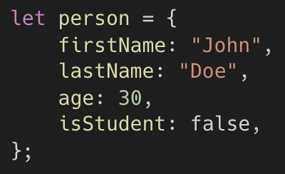
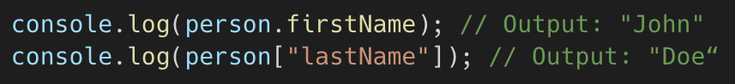
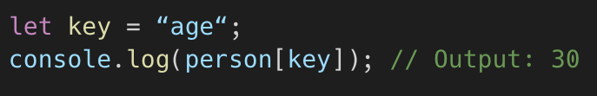
Objects (1)
An Object is a collection of key-value pairs, where each key is a string (also known as a property name), and each value can be of any data type, including primitive types, arrays, other objects, and functions. Objects are used to represent structured data and to group related information together.
You can access object properties using dot notation or square brackets.
You can also access object properties from a variable using the square bracket

Slide 13
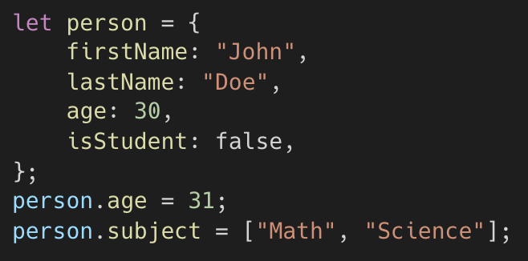
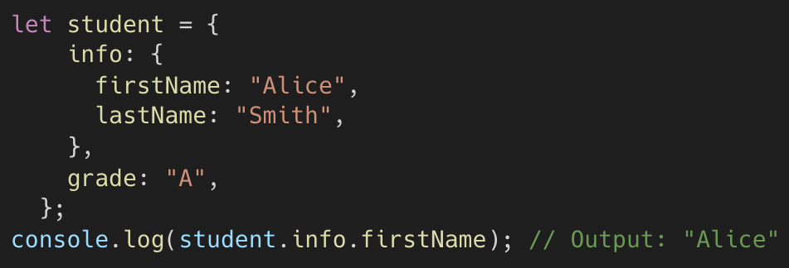
Objects (2)
Object properties can be modified or added after object creation.
Objects can contain other objects as properties, creating a nested structure.

Slide 14
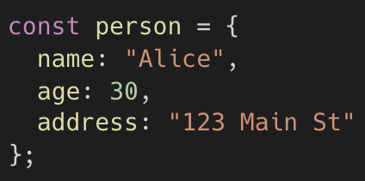
Arrays vs Objects Summary
Arrays​ | Objects​
Ordered collection of values​ | Collection of key-value pairs​
Declaration:​ | Declaration:​
Indexed by numeric indices (0, 1, 2, …)​ | Indexed by keys (property names)​
Access elements by index (e.g. )​ | Access properties by name (e.g., , )​
Order of elements matters​ | Order of properties doesn’t matter​

Slide 15

Exercise
1. Favorite food list:
Create an array of your favorite foods and display them in the console.
Add a new food to the array and display the updated list.
Remove the first food from the array and display the updated list.
2. Creating and Accessing Object Properties:
Create an object to represent a person with properties like name, date of birth, and city.
Display the person's name and city in the console.
Modify the person object to change the city property & display the updated city in the console.

Slide 16
Loops
Section 3

Slide 17
What is Loop?
Loops are used to perform the same task or a set of tasks multiple times.
They allow us to iterate over a sequence of values, like numbers in a range or elements in an array.
Without loops, we would have to write the same code over and over for each iteration, which is not practical.
There are 3 types of loops”
For loops
While loop
Do while loop

Slide 18
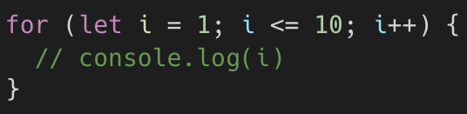
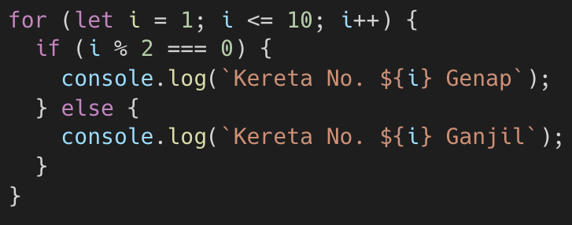
For Loop
The for loop is a control structure in JavaScript that allows you to execute a block of code repeatedly for a specified number of iterations. It is ideal when you know the number of iterations in advance.
Is structured with three parts: initialization, condition, and iteration.
Initialization sets the loop control variable.
The condition determines whether the loop should continue executing.
The iteration expression updates the loop control variable after each iteration.
Example:
initialization
condition
iteration
Be careful with the initialization, condition, and iteration expressions to ensure the loop behaves as expected and doesn't result in an infinite loop.

Slide 19
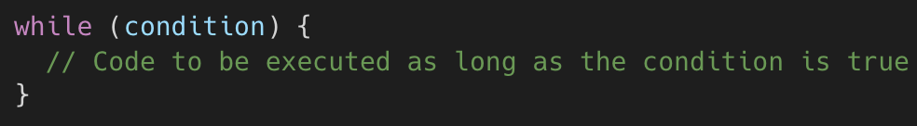
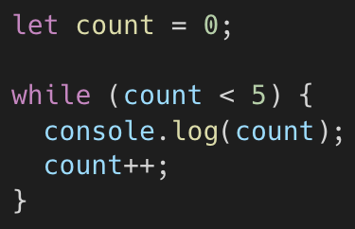
While Loop
The while loop is used to execute a block of code as long as a specified condition is true.
The condition is evaluated before the loop body is executed. If the condition is true, the loop body is executed.
After each iteration, the condition is checked again. If it's still true, the loop continues. If it's false, the loop terminates.
Example:

Slide 20
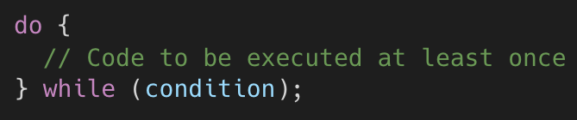
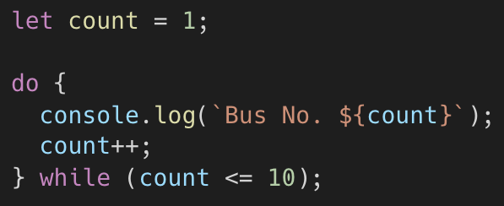
Do While Loop
The do...while loop is similar to the while loop but with one key difference: it always executes the loop body at least once, regardless of whether the condition is true or false initially.
If the condition is true, the loop will continue executing.
If the condition is false, the loop terminates.
Example:

Slide 21



Exercise
Display item in a list:
Create an array listing discography of an artist.
Display all items in the array as a list with the item number
Factorial
Input an integer number
Count the factorial for said number and display the number

